Slide 1

Mapping Happiness and Frustration Index on top of the world map through tweets
Chandra Prakash Khatri* M.Karthikeyan# Raja V Palanisamy*
*College of Computing, Georgia Institute of Technology#Bioinformatics, School of Biology, Georgia Institute of Technology

Slide 2



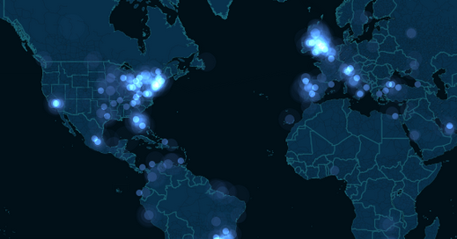
Problem Statement
Extract live feeds from twitter in real-time, mine the data obtained and perform natural language processing and classify the data obtained to eventually map ‘happiness’ and ‘frustration’ on top of the World Map, by calculating the sentiments of the tweets
Data extraction
Data Mining
Sentiment analysis

Slide 3
Data Extraction
Tweets
Twitter REST API^{[4]}, Twitter Search API^{[4]}
Twitter does not provide completely mined streams
JSON format.
Python libraries for removing the noise
TweeQL, Tweepy^{[1]} provides interfaces to extract tweets
Remove retweets
#tags, emoticons
Location Data
Only 3% tweets are geo-annotated ^{[2] [3]}
Extracting geo-location using POS tagging
Bounding box and location from users profile
From past tweets or connections

Slide 4
Data Extraction
Natural Language Processing
NLTK^{[5]}
Tokenizing streams/word segmentation
Obtaining POS
Location Data

Slide 5
Sentiment Analysis
Library - two options
Create our own dictionary of words
classify them as happy/sad
specify rating to each word
Use ANEW dictionary*
has database of 1034 words
has valence, arousal, dominance measures
* The Center for the Study of Emotion and Attention, University of Florida
Compute happiness measure for each word
Compute average happiness measure
Tweet
Mark it on map

Slide 6
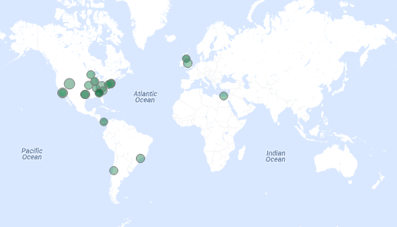
Visualization
Limitations of currently functional
visualizations
eg- Sentiment viz ^{[7]}
lack a dynamic ,real time feature
CartoDB ^{[6]}
Open Source - built on PostgreSQL,PostGIS,Mapnik,NodeJS Provides javascript and CSS libraries - CartoDB.js , CartoCSS
A repository of Mapping APIs
http://mashable.com/2014/03/04/see-all-the-oscar-night-twitter-activity/
#SXSW Time
www.csc.ncsu.edu/faculty/healey/tweet_viz/tweet_app/

Slide 7


USPs
Location based ‘sentiment mapping’
Dynamic visualization
Broad Applications
Visualize the brand analytics through emotions
Predict the stock variation
Advertising
Fun stuff - The rise and fall of flappy bird
source:www.mediabistro.com
source:www.mobenzi.com

Slide 8
Heilmeier’s questions
Objectives | Dynamic Visualization of Happiness/Frustration Index
Current Technology/Limits | Static, Limited NLP,Geolocation^{[2][3]}
What are we doing differently? | Dynamic, Exact Location Mapping, Extensive NLP
Who cares? | Sociologists,Psychologists,Stock Market Analysts,Brand Analytics
Impact | Potential to replace existing expensive surveys.
Risks & Payoffs | Latency issues,Limitations on number of client requests^{[1]}
Cost/Time | Free (Open-source tools). 2 months
Check points | Mid-term: Data Extraction, Mining, Sentiment Analysis Final: Classification, Location Mapping, Visualization

Slide 9
Work Schedule
 | Week 1 -2 | Week 3-4 | Week 5-6
Chandra | Extract twitter feed data through APIs | Sentiment Analysis/Classification of the extracted tweets | Visualize using CartoDB APIs
Karthikeyan | Keyword Database creation and scoring indexes | Preliminary Visualization | Visualize using CartoDB APIs
Raja | Mine the extracted data for NLP filtering | Classification of the extracted tweets | Visualize using CartoDB APIs

Slide 10
References
[ 1 ] Marcus, A., Bernstein, M. S., Badar, O., Karger, D. R., Madden, S., & Miller, R. C. (2012). Processing and visualizing the data in tweets. ACM SIGMOD Record, 40(4), 21-27.
[ 2 ] Mahmud, J., Nichols, J., & Drews, C. (2012, May). Where Is This Tweet From? Inferring Home Locations of Twitter Users. In ICWSM.
[ 3 ] Hecht, B., Hong, L., Suh, B., & Chi, E. H. (2011, May). Tweets from Justin Bieber's heart: the dynamics of the location field in user profiles. In Proceedings of the SIGCHI Conference on Human Factors in Computing Systems (pp. 237-246). ACM.
[4 ] https://dev.twitter.com/docs/api/1.1
[5] http://www.nltk.org/
[6 ]www.cartodb.com
[7 ]www.csc.ncsu.edu/faculty/healey/tweet_viz/tweet_app/

Slide 11


Questions ?

